Slide 1
Health Literacy – what is it ; why it matters and what to do about it
Professor Don Nutbeam
Prevention Research Collaboration, School of Public Health, University of Sydney, Australia
Health Literacy Forum – Launceston, Tasmania
29th October 2019

Slide 2

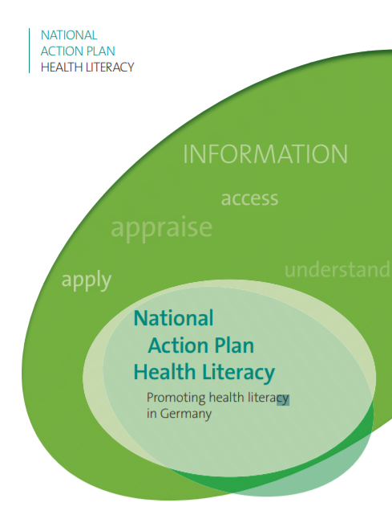

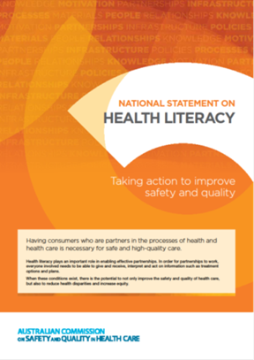
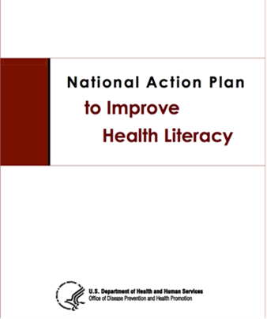
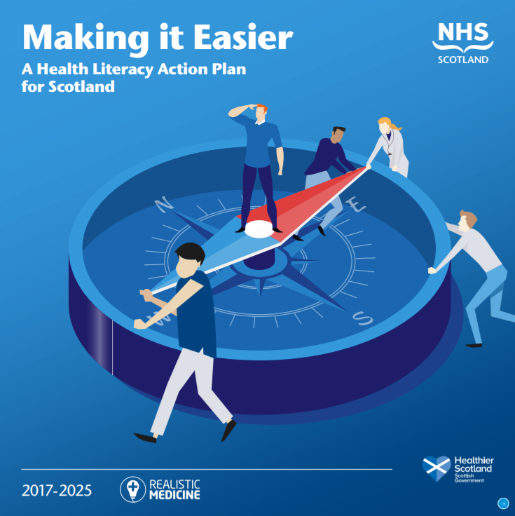
Health literacy has become a priority for many countries across the world

Slide 3
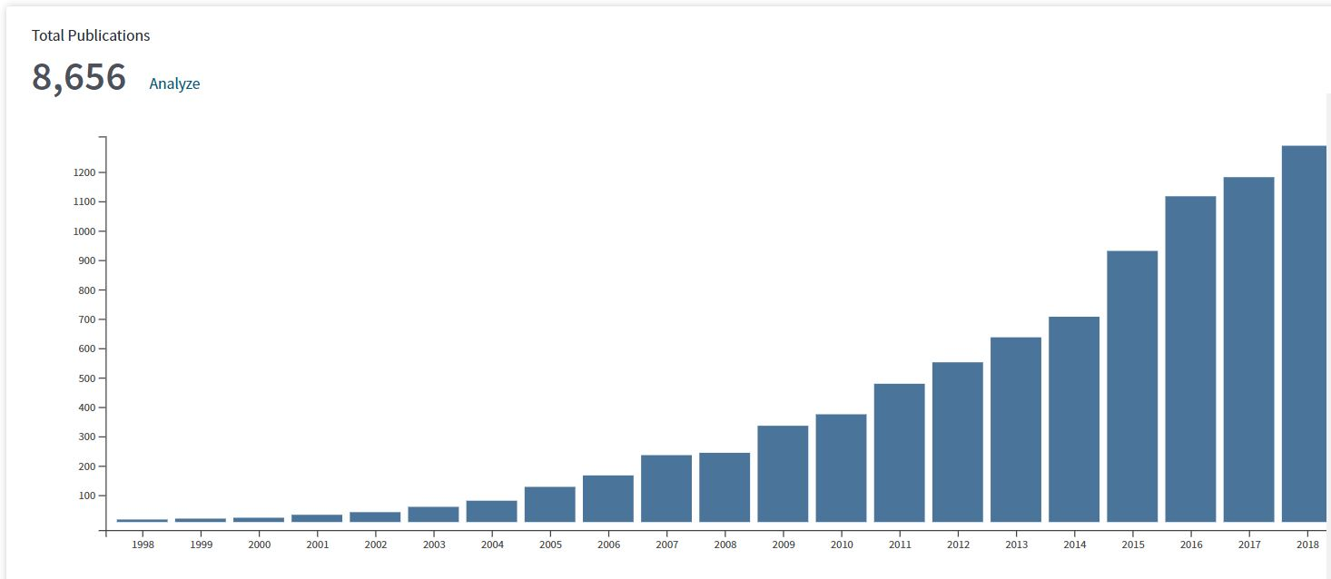
Health Literacy has become a popular research topic: Rise in publications on “health literacy” 1998-2018
Chart from Thomson-Reuters Web of Science database. Accessed January 2019

Slide 4
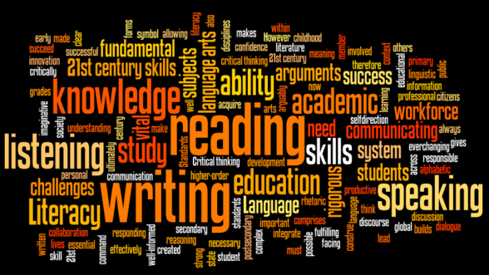


Literacy, Health and Health Literacy
What is literacy?
Functional literacy is defined as a tangible set of skills in reading, writing (and numeracy) and the capacity to apply these skills in everyday situations
Literacy is important
Literacy skills enable people to better develop their knowledge and improve their potential to achieve personal goals.
Individuals are able to participate more fully in society and the economy.
Fully developed literacy comprises transferable skills in obtaining and using information to engage in decisions in more interactive and critical ways
Notes:
If using a school logo, make sure that if you have a long page title, it does not encroach on the logo. Allow about 2cm around the logo. Run the page title onto two lines if necessary.

Slide 5
Literacy has an impact on health
Relationship between low literacy and a range of health related outcomes well established
Some indirect effects related to employment and lifetime income
Some direct effects of low literacy, individuals are*
  Less responsive to health education,
  less likely to use disease prevention services, and
  Less likely to successfully manage chronic disease
*Berkman N D, Sheridan SL, Donahue KE, Halpern DJ, Crotty. 2011. Low Health Literacy and Health Outcomes: An Updated Systematic Review. Annals of Internal Medicine, 155, 97-107
Notes:
If using a school logo, make sure that if you have a long page title, it does not encroach on the logo. Allow about 2cm around the logo. Run the page title onto two lines if necessary.

Slide 6


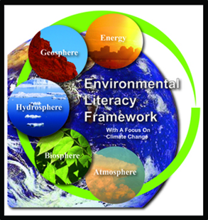
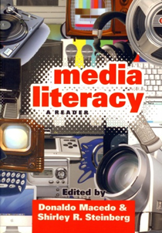

Literacy skills are significantly moderated by the context in which they are applied
More accurate to talk about literacies
  Financial literacy,
  Science literacy
  Media literacy,
  Environmental literacy
  Digital literacy and,
  Health literacy
Notes:
If using a school logo, make sure that if you have a long page title, it does not encroach on the logo. Allow about 2cm around the logo. Run the page title onto two lines if necessary.

Slide 7
Defining health literacy
Health literacy describes the cognitive and social skills which determine the motivation and ability of individuals to gain access to, understand and use information in ways which promote and maintain health* in different situations
*Nutbeam D. Health Promotion Glossary (1998) Health Promotion International, 13(4): 349-364. (also - WHO/HPR/HEP/98.1)

Slide 8
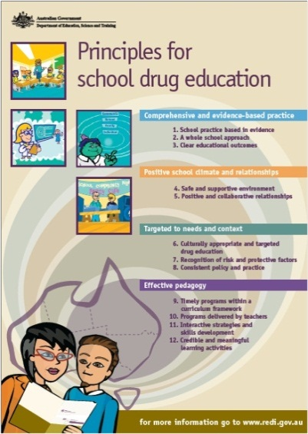
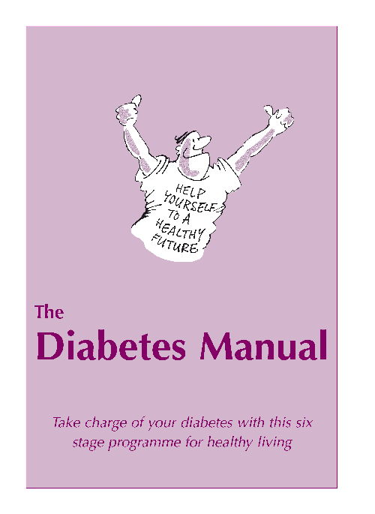
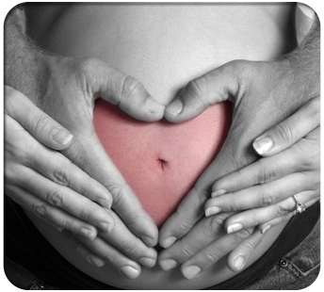
Health literacy is an observable set of skills that are situation specific.
The ability to apply these skills vary from individual to individual:
- in changing contexts (health services, community)
- at different stages across the life-course.
  A young person receiving health education on illicit drugs at school
  A person in their 50s
  with diabetes who
  is receiving patient education in a clinic
A pregnant woman attending
ante-natal classes in the community

Slide 9
Health literacy is determined by personal skills and context in which those skills are to be applied
Personal skills
and abilities
Health literacy
Situational demands and complexity
Personal skills
and abilities
Adapted from Ruth Parker, Measuring health literacy: What? So what? Now what? In Hernandez L, ed. Measures of health literacy: workshop summary, Roundtable on Health Literacy. Washington, DC, National Academies Press, 2009:91–98
https://www.ncbi.nlm.nih.gov/books/NBK45386/

Slide 10
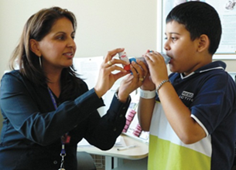
Relative differences in health literacy
Health literacy describes an observable set of skills that vary from individual to individual; can be classified*; can be measured, and can change.
Functional, interactive and critical health literacy
Functional health literacy
Basic health literacy skills sufficient for individuals
to obtain and apply health information to a
limited range of activities.
*Nutbeam D. (2000) Health Literacy as a Public Health Goal: A challenge for contemporary health education and communication strategies into the 21st Century. Health Promotion International, 15; 259-67

Slide 11
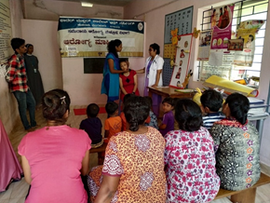
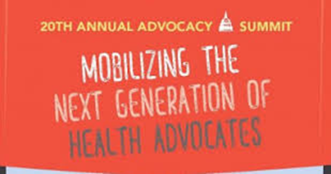
Relative differences health literacy
Interactive health literacy
More advanced literacy skills that enable individuals to differentiate information from different communication; apply new information to changing circumstances; and to interact with greater confidence with information providers such as health care professionals.
Critical health literacy
Most advanced health literacy skills that can be applied to critically analyze information, and to use this information to exert greater control over life events and situations.

Slide 12
People move between categories of health literacy
Functional, interactive and critical health literacy are not static constructs
Moving between categories of health literacy progressively indicates greater autonomy in decision-making, and personal empowerment.
Progression between categories is not only dependent upon skills development (reading, writing, numeracy), but also exposure to different forms of information (communication content and media).
It is also dependent upon a person’s confidence to respond to health communications – described as self-efficacy.
Both moderated by the context in which communication occurs

Slide 13
Health Literacy can be measured
Several simple measures of health literacy have been tested, refined and validated over the past 20 years for use as screening tools in clinical practice.
These are generally insufficient to measure relative differences in health literacy and work is underway to develop more complex measures for health literacy.
These measures include assessment of a person’s ability to
  gain access to age and context specific information from a variety of different sources;
  discriminate between sources of information
  understand and personalize health information that has been obtained
  apply relevant health information for personal/family/community benefit
https://healthliteracy.bu.edu/

Slide 14
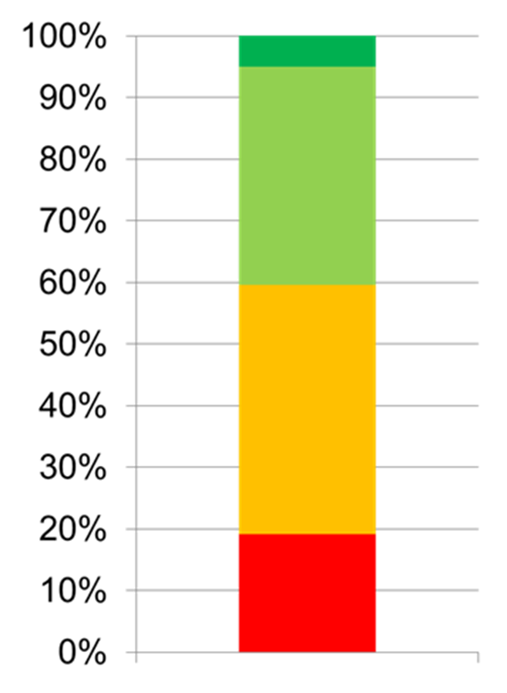
Countries that have undertaken health surveys have generally found that poor health literacy is more common that most people think
Australian Bureau of Statistics 2008
41% of adults were assessed as having adequate or better health literacy skills, scoring at Level 3 or above.
  Able to perform tasks such as combining information in text and a graph to correctly assess the safety of a product.
Around one-fifth (19%) of adults had level 1 health literacy skills, with a further 40% having Level 2. These people had difficulty with tasks like:
  locating information on a bottle of medicine about the maximum number of days the medicine could be taken, or
  drawing a line on a container indicating where one-third would be (based on other information on the container).

Slide 15


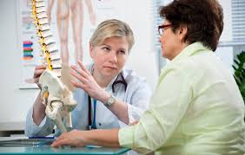
Health literacy matters
In health, education and social systems
  Where there is need for more effective prevention,
  Where there is commitment to person-centred care, and
  Where there is greater than ever dependence on patient self-management of chronic conditions.
where there is a commitment to equity - there is a strong social gradient in health literacy - those with greatest need are generally least able to respond to the demands of the health care system
Richler K et al.
The costs of limited health literacy:
a systematic review.
International Journal of Public Health;
2009; 54(5): 313–324.
doi: 10.1007/s00038-009-0058-2

Slide 16


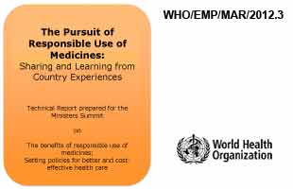
Improving the health literacy environment matters….
24-36 hrs after Emergency Department discharge: 80% of patients did not understand home care instructions*.
WHO estimates that more than half of all medicines are prescribed, dispensed or sold inappropriately, and
That half of all patients fail to take them correctly**
*Engel KG et al. Patient understanding of emergency department discharge instructions: where are knowledge deficits greatest? Academic Emergency Medicine. 2012 Sep;19(9):E1035-44. doi: 10.1111/j.1553-2712.2012.01425.x
**https://www.who.int/medicines/areas/rational_use/en/
***https://www.who.int/medicines/areas/rational_use/rud_activities/en/

Slide 17
How do we change things?
Personal skills
and abilities
Health literacy
Situational demands and complexity
Personal skills
and abilities

Slide 18
How do we change things?
Reducing the complexity
of communication
Personal skills
and abilities
Health literacy
Situational demands and complexity
Personal skills
and abilities

Slide 19
How do we change things?
Reducing the complexity
of communication
Personal skills
and abilities
Health literacy
Situational demands and complexity
Personal skills
and abilities
Increasing the skills and
confidence of consumers

Slide 20
Improving health literacy in clinical care
There are strong practical and ethical reasons to actively involve patients in shared and informed clinical decision-making, and in self management of conditions - especially long term and continuing conditions.
Past research* has indicated that active involvement of patients produces better health outcomes for patients and greater patient satisfaction. This is observable through
  Improved use of medicines
  Improved uptake of preventive practices
  Appropriate use of health services and reduced unplanned hospital admissions
  Reduced health care costs
  *Sheridan et al. (2011). Interventions for individuals with low health literacy: a systematic review. Journal of Health Communication, 16(s3): 30-54.

Slide 21
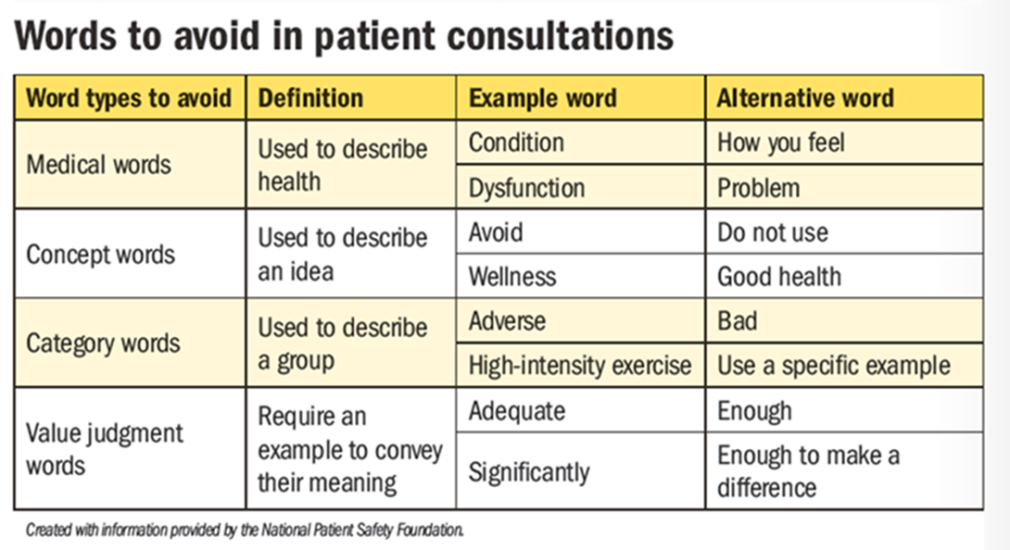
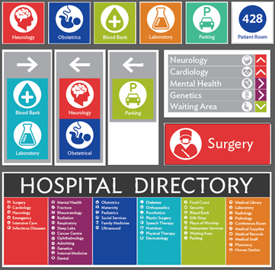
Reducing the complexity of communication
We need to put into practice what works
Low health literacy can be improved through*:
Modifications to communication, for example by using simplified text and pictures in written communications
Placing emphasis on building knowledge and cognitive skills, for example by using teach-back methodologies, shared decision-making techniques
Modifications to organisation of health services to reduce the “literacy burden” on patients and visitors

Slide 22

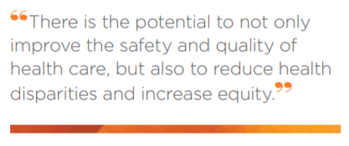
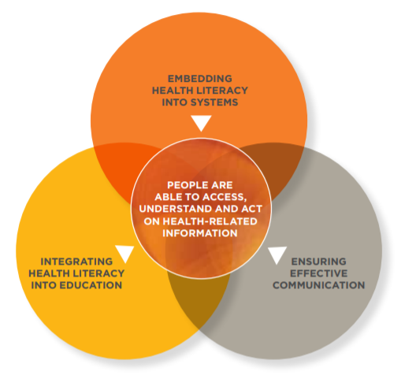
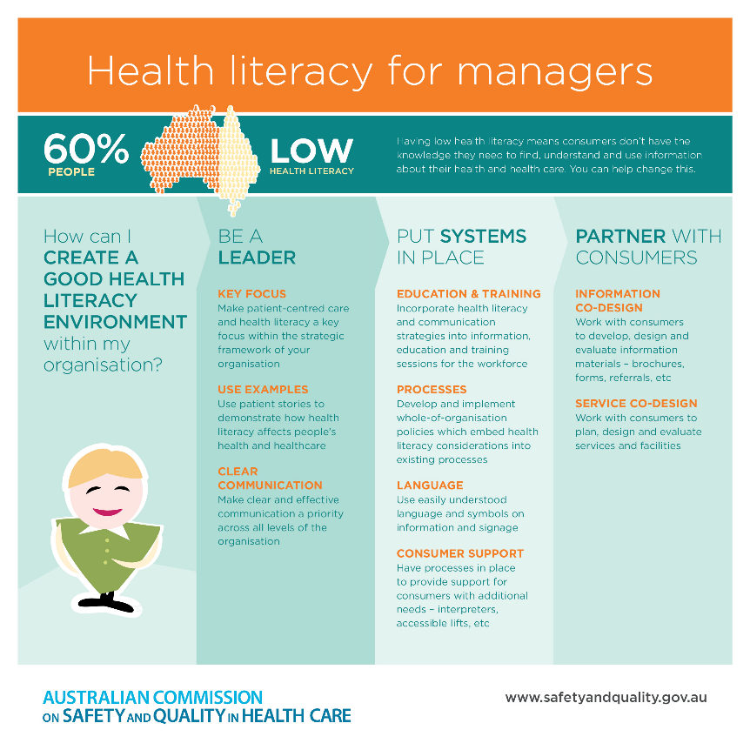
Improving health literacy in clinical care is a national priority supporting health system safety and quality:
National Standards – http://www.nationalstandards.safetyandquality.gov.au/
:
National Statement: https://www.safetyandquality.gov.au/wp-content/uploads/2014/08/Health-Literacy-Taking-action-to-improve-safety-and-quality.pdf

Slide 23
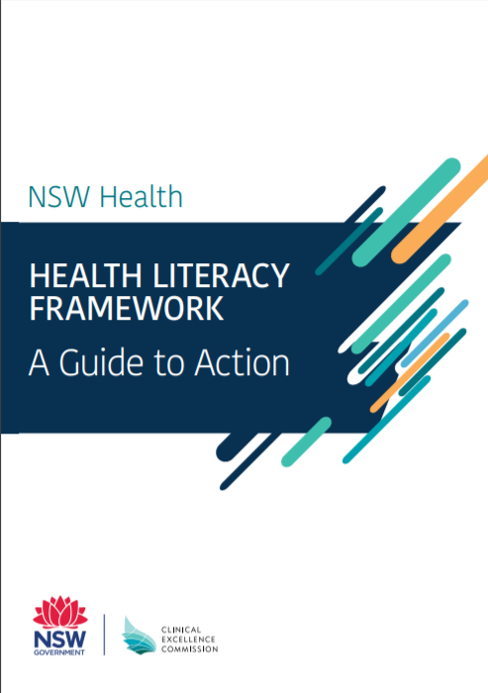
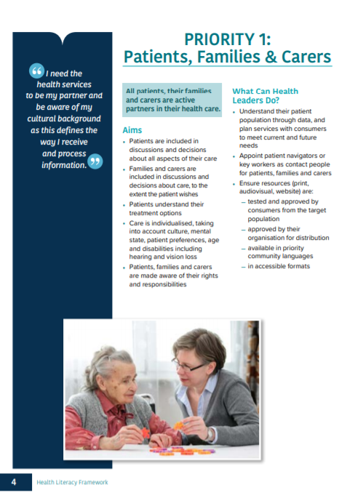
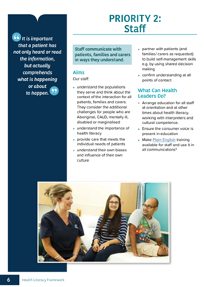
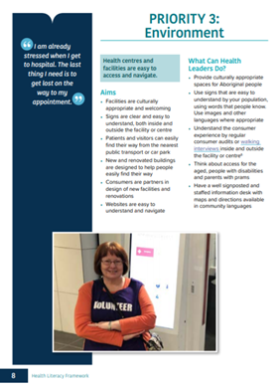
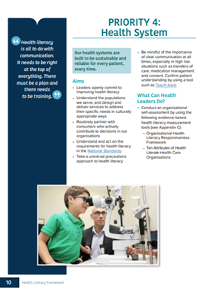
Improving health literacy in clinical care is a State priority – NSW Clinical Excellence Commission
See NSW: http://www.cec.health.nsw.gov.au/__data/assets/pdf_file/0008/487169/NSW-Health-Literacy-Framework-2019-2024.pdf
See also Tasmania: https://www.dhhs.tas.gov.au/publichealth/health_literacy

Slide 24


Improving health literacy is a local priority:
The Western Sydney Local Health District Health Literacy Hub
Making health choices easy for everyone
The hub is a place to connect people interested in improving health literacy in Western Sydney – a community connected to best practice locally and the best in the world
A resource to support rapid translation of best practice between and across primary and secondary healthcare settings
A source of tools and advice for capacity-building on how to improve communication with patients, relatives and carers, and members of the community
A point of connection to the University of Sydney Health Literacy Lab – developing and testing innovations in health literacy
See also: Northern NSW - https://healthliteracy.nnswlhd.health.nsw.gov.au/

Slide 25

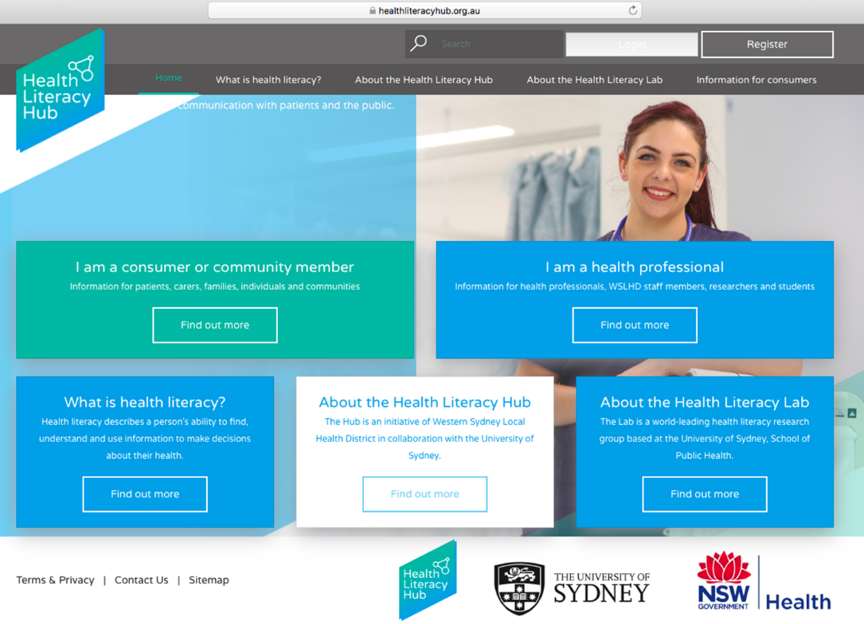
healthliteracyhub.org.au
Hub website
Organised on three levels
Level 1
Publically accessible
Level 2
Accessible through registration to health professionals and academic community
Level 3
Patient Communication and Advice Portal (PCAP)
Accessible to health staff

Slide 26

Sydney Health Literacy Lab:
Our work seeks to build research partnerships and educational opportunities to:
Understand the diverse needs of the community and health care services
Develop new knowledge, skills or solutions to address those needs
Implement these effectively and sustainably in the community and health system
AIM: to create a body of knowledge and models of best practice in health literacy
https://sydneyhealthliteracylab.org.au/

Slide 27
Improving health literacy in community populations
Reports on health literacy interventions with community (non-clinical) populations not as common in the published literature*
Positive examples of researchers engaging meaningfully with communities to design interventions.
Reported interventions were highly specific to populations and/or localities
Health literacy informed the intervention design or evaluation
Some conflation of traditional health education interventions, with interventions designed to improve health literacy
Reviews provide consistent if not yet compelling evidence of the feasibility and potential effectiveness of health literacy interventions conducted with, and within communities.

Slide 28

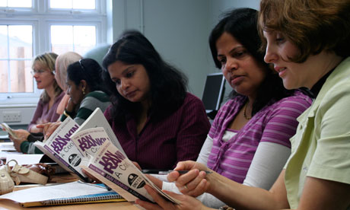
Improving health literacy in community populations . Case Study: HEALTH LITERACY TAFE PROJECT
Aim was to develop and evaluate an Australian Health Literacy Program for delivery in TAFE colleges in NSW
Based on the UK ‘Skilled for health’* program
Embedded health content into an established language, literacy and numeracy foundation skills program
ARC Linkage grant
*http://www.chlfoundation.org.uk/data/sfh2/sfh2_intro.pdf
Notes:
I am going to cover 3 main areas>
First supporting SDM among adults with low ed and literacy
2nd I am going to present some results of a trial of a literacy sensitive decision aid (a SDM intervention)
And 3rd – I am going to talk more briefly about how we might identify and target adults with lower literacy

Slide 29
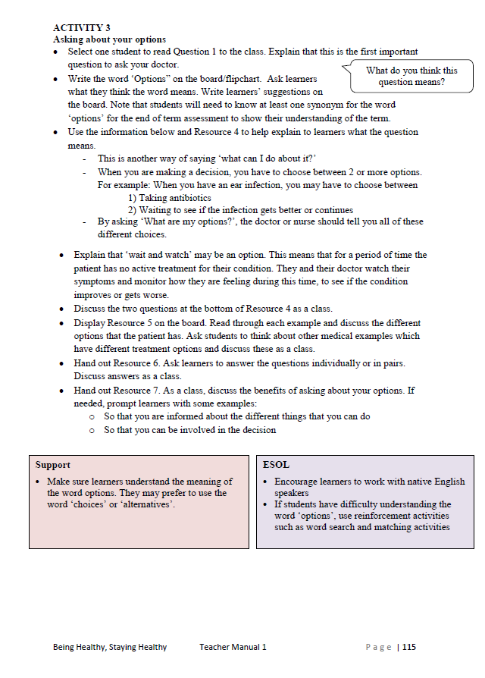
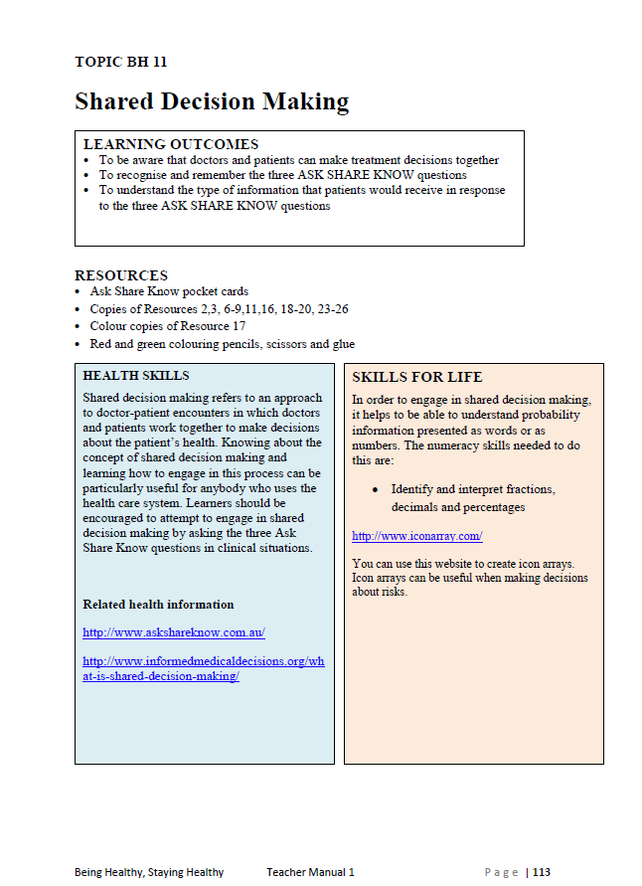
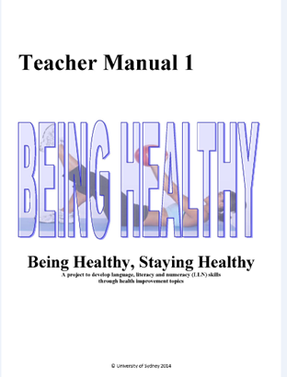
Modules
Guided lesson plan
    Detailed delivery instructions
    Suggested discussion questions
Resources
    Worksheets
    Diagrams / images
Answers

Slide 30
TRIAL DESIGN
Adult learners n=308
23 TAFE colleges
*Quantitative Measures
Functional HL skills (temp, labels: medicine + nutrition)
HLQ – generic scale
Confidence
Question asking/ SDM
Involvement preferences
Baseline assessment*
Intervention:
HL program
Control:
Usual LLN
Qualitative interviews:
30 students
All teachers (n=37)
All CHW
18 weeks
End of course assessment*
6 month follow-up:
HLQ scale, self-reported question asking, DM involvement

Slide 31
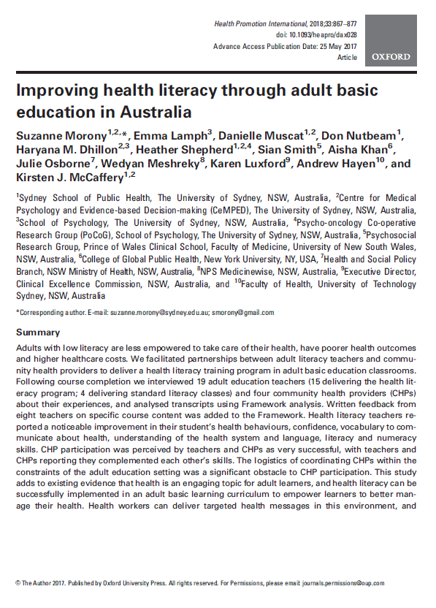
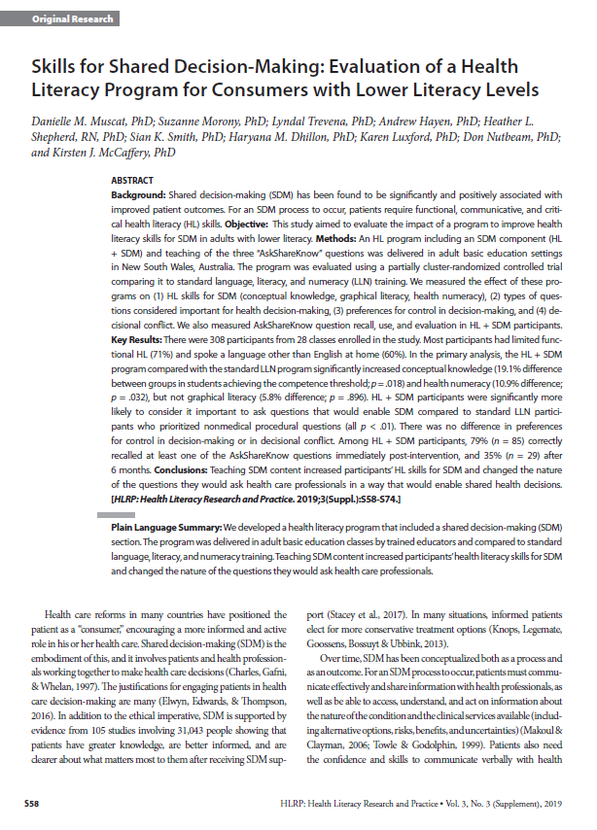
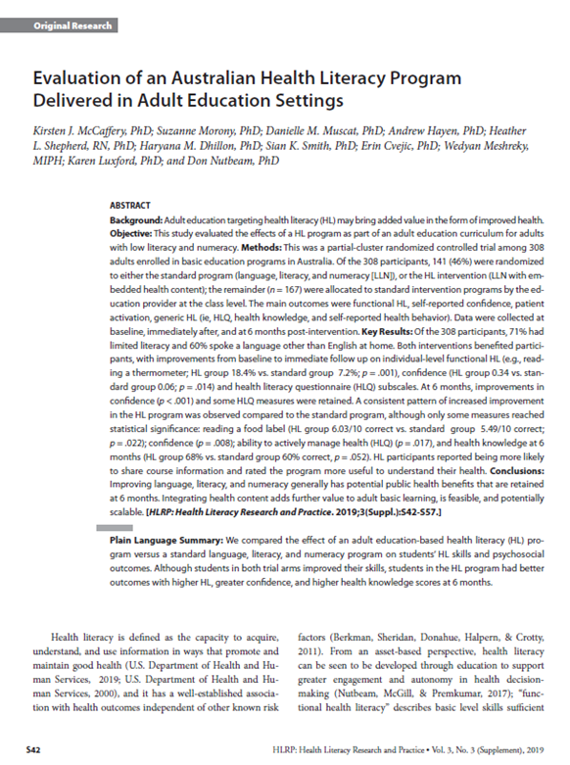
What were the outcomes?
2. Positive gains in health
literacy in intervention
and control group
1. Practical to implement,
valued by learners and
teachers alike
3. Significant additional gains
in skills for shared decision-making

Slide 32
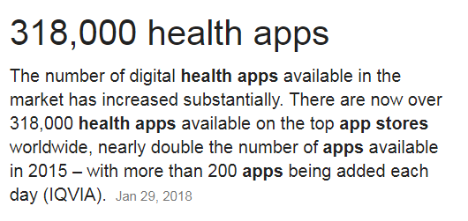
Improving digital health literacy
Almost limitless possibilities for improving access to information
Early stages in understanding how to develop transferable skills and support decisions about health – research evolving
But:
Overwhelming choice of sources (for some), digital health literacy must incorporate skills in identifying credible, useable sources of information - Trust or trash (www.trustortrash.org )

Slide 33
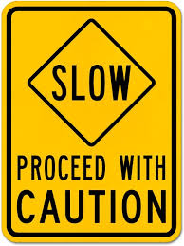
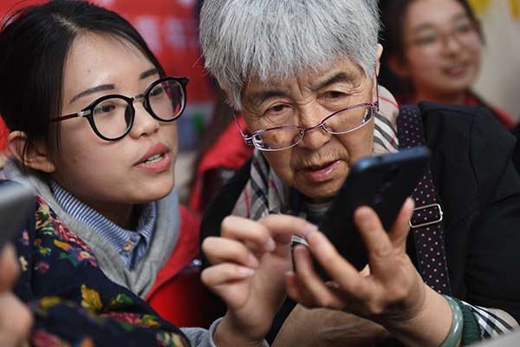
Digital health literacy – proceed with caution
Vast majority of current online sources not providing information in plain language, usable format
Great majority of apps of unproven benefit
Use of digital platforms most common among younger, more economically advantaged populations
Progress dependent upon:
  Helping people to develop generic digital health literacy skills;
  Improving quality and effectiveness of Apps through research and evaluation
  Connecting right person to right app
  Broadening access to digital platforms

Slide 34
Conclusions – the stakes are high
Health literacy fundamentally dependent upon levels of basic literacy in the population
Definition and measurement of health literacy still evolving and can usefully draw down on existing concepts, definitions and measurements from general literacy
Inadequate health literacy is more common than expected, and is most common among those who are already socially disadvantaged. If we don’t change our approach we will increase existing inequalities
Higher levels of health literacy in a population support a wide range health actions to promote health and wellbeing; prevent ill-health; and better manage existing illness
Notes:
If using a school logo, make sure that if you have a long page title, it does not encroach on the logo. Allow about 2cm around the logo. Run the page title onto two lines if necessary.

Slide 35
Conclusions – we need to put into practice what we know to be effective
Focussing health education and communication on the development of health literacy skills across the life-course,
Harnessing the potential of digital technologies
Developing capacity (among educators and clinicians) to respond successfully to the challenges of low health literacy through professional education and continuing professional development
Creating consumer environments that are supportive for health, ensuring service organisation and delivery is sensitive to low health literacy

Slide 36
Conclusions – practical action is possible
These things take time – patience is a virtue –
Population data are an important starting point for a policy discussion/advocacy
Alignment with health system quality and safety is a powerful starting point
Alignment with consumer and community engagement sustains commitment and opens a broader range of opportunities
Responses need to be at different levels (National, State/regional, local) to support tangible, practical actions
Little changes without the active engagement of front-line workers

Slide 37
Conclusions – we need more intervention research
Interventions that are context and content relevant are likely to be more successful in producing sustainable change. These include:
  linked to critical life stages (eg adolescence, parenthood, aging and retirement) and
  critical life events (eg diagnosis of pre-diabetes/diabetes)
Intervention development still at an early stage, more experimentation, better measurement and better evaluation is needed, especially in community settings

Slide 38
The end
Thanks for your attention

